Slide 1
E-Commerce Sales Analysis Project
End-to-End E-Commerce Sales Analysis Using Python &
MySQL – From Raw Data to Business Insights
with SQL Window Functions, Aggregates & Trends
By: Nishant Kumar Sharma | Aspiring Data Analyst

Slide 2
Dataset Source: Amazon E-Commerce Data (inspired by Kaggle)
Records: 100000+ rows
Columns: index, Order_ID, Date, Status, Fulfilment, Sales_Channel ship_service_level, Style, SKU, Category, Size, ASIN, Courier_Status, Qty, Amount, ship_city, ship_state, Total Sales
Objective: Perform SQL-based analysis to extract trends, patterns, and KPIs

Slide 3

Business Questions & SQL Queries
Total Orders Count
Query: -
Select count(order_ID) as Total_Orders
from sales_data;
Notes:
from sales_data;

Slide 4
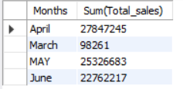
Business Questions & SQL Queries
2. Monthly Sales
Query: -
Select
CASE
WHEN Month(Date) = 3 THEN 'March'
WHEN Month(Date) = 4 THEN 'April'
WHEN Month(Date) = 5 THEN 'MAY'
WHEN Month(Date) = 6 THEN 'June'
End as Months,
Sum(Total_sales)
from Sales_Data
group by Months;

Slide 5
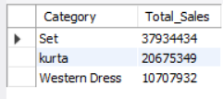
Business Questions & SQL Queries
3. Top 3 Category Sales
Query: -
Select Distinct(Category), sum(Total_Sales) as Total_Sales
from Sales_Data
group by Category
LIMIT 3;
Set Category shows highest sales

Slide 6
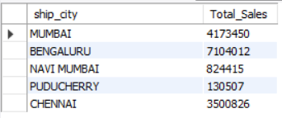
Business Questions & SQL Queries
4. Top 5 City Sales
Query: -
select distinct(ship_city), sum(Total_Sales) as Total_Sales
from Sales_Data
group by ship_city
Limit 5;

Slide 7
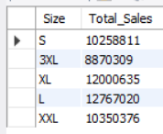
Business Questions & SQL Queries
5. Top 5 size sales
Query: -
Select distinct(Size), Sum(Total_Sales) as Total_Sales
from Sales_Data
group by Size
LIMIT 5;

Slide 8
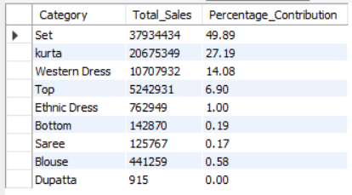
Business Questions & SQL Queries
6. % contribution of each category
Query: -
Select Category,
sum(Total_sales) as Total_Sales,
round(100.0 * sum(Total_Sales) /
(Select Sum(Total_Sales) from Sales_Data), 2)
as Percentage_Contribution
from Sales_Data
group by Category;

Slide 9
Techniques & Tools Used
🐍 Python (Jupyter Notebook) – Exploratory Data Analysis (EDA)
Loaded raw dataset using pandas
Handled missing values and nulls
Formatted date column to correct data type
Created a new ‘Total_Sales’ column using (Qty * Amount)
Exported cleaned dataset to Excel
🐬 MySQL – Data Analysis
Loaded cleaned Excel into MySQL
Performed queries using:
✅ SELECT, WHERE, GROUP BY, ORDER BY
🔁 Aggregations: SUM, AVG, COUNT
📊 Window Functions: RANK(), DENSE_RANK(), ROW_NUMBER(), LAG(), MOVING_AVG
🧱 CASE statements, CTEs, HAVING
⚡ Performance optimization with INDEX

Slide 10
Insights & Observations
✅ Set category had the highest sales
🏙️ Mumbai & Bengaluru contributed most to revenue
📈 Sales increased by 28% from March to June
❌ ~14% orders were cancelled
👕 Size 'M' most frequently ordered
🔁 50+ duplicate orders found → Possible system issue
🛒 Amazon.in was dominant channel
📅 Most sales happened on weekends
🚚 Shipped orders = 90% of revenue

Slide 11
Challenges & Learnings
Working with real-world messy data
Efficient SQL query writing
Understanding business metrics through data
Performance optimization using INDEX

Slide 12
THANK YOU
📩 Email: nish.sh27@gmail.com
GitHub: github.com/Nishantksh277
LinkedIn: linkedin.com/in/nishantksharma
Portfolio: Nishant Sharma Dataset: Kaggle
Phone: 8799720977

